Slide 1
Abstract factory
Design Patterns

Slide 2
Intent
Provide an interface for creating families of related or dependent objects without specifying their concrete classes.
WTF?
A note about patterns first…
Notes:
It is at least as important to understand when NOT to use a pattern, as to understand when they can be used!

Slide 3
What Is It
Allows changes to implementation without hassling the client
Can change implementation at run time
Client codes to the interfaces, not the implementation
Every time you use “new,” an angel loses its wings
Parallel Hierarchies of Objects
Notes:
Changes to implementation: the specific implementation might even change at runtime, based on a STRATEGY.

Slide 4
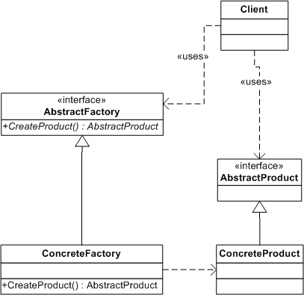
Pretty UML
Notes:
Client is aware of AbstractFactory and AbstractProduct.
Can be many implementations of the interfaces, doing remarkable things.

Slide 5
First Code Example
Complete Implementation

Slide 6
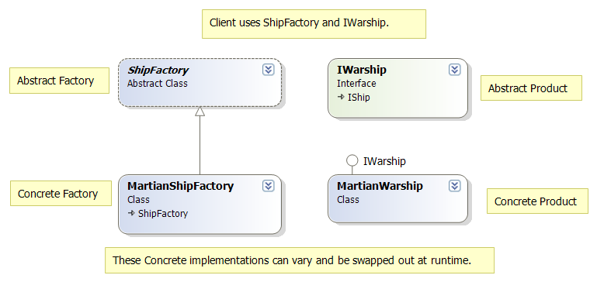

Slide 7
Next Code Example
Dependency Injection / Spring
Relationships (and differences) between DI and Abstract Factory

Slide 8
Consequences
Isolate Concrete Classes
…but also isolates specialization
Exchanging Product Families is easy
…how often do you really need to do that?
Adding new Product Families is difficult

Slide 9
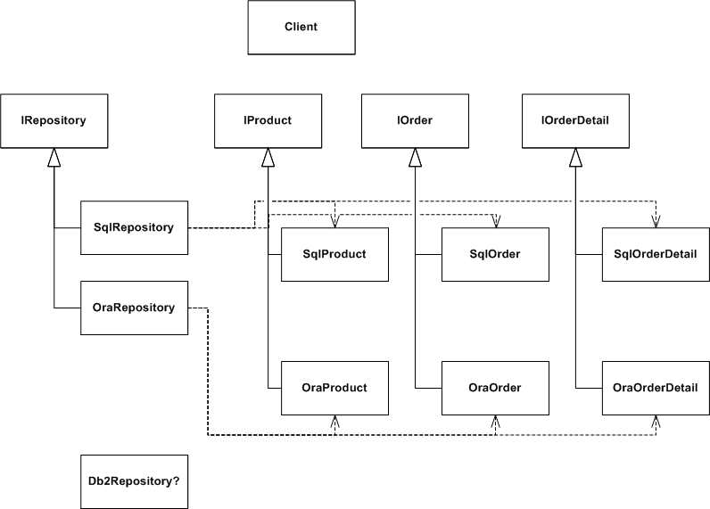
Not-So-Pretty UML
Notes:
Don’t be this guy.
What happens when you add another repository type? Yes this is a contrived example, but its easy enough to happen. Later we’ll see in the Bridge pattern a way to avoid this.

Slide 10
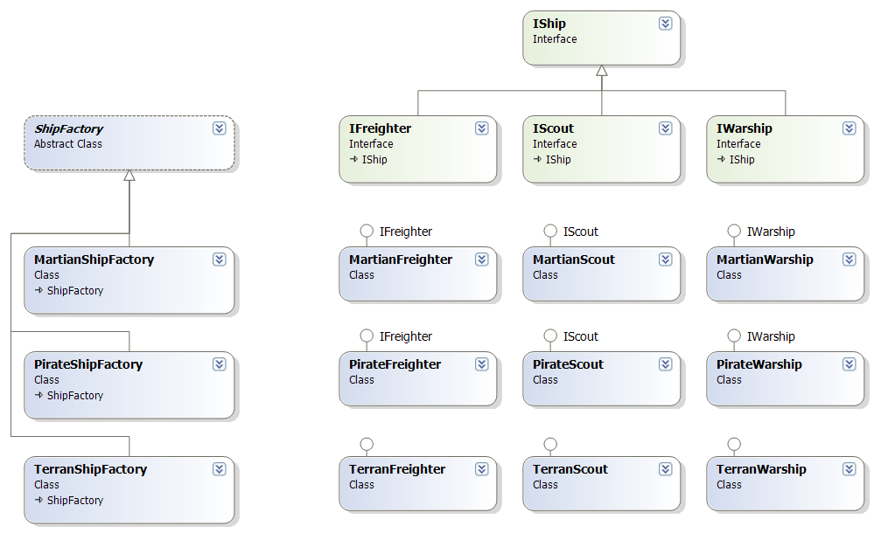
Multiplicative Effect
Notes:
Adding a new ship type = whole new column to this diagram (multiplicative)
Adding a new ShipFactory type = whole new row to this diagram (multiplicative)
When this starts to happen, maybe Abstract Factory isn’t the best pattern to use.

Slide 11
Questions

